Slide 1
Controlling a Stage

Slide 2
Controlling a Stage
PRINCE2® manual page 167
Workbook page 247

Slide 3
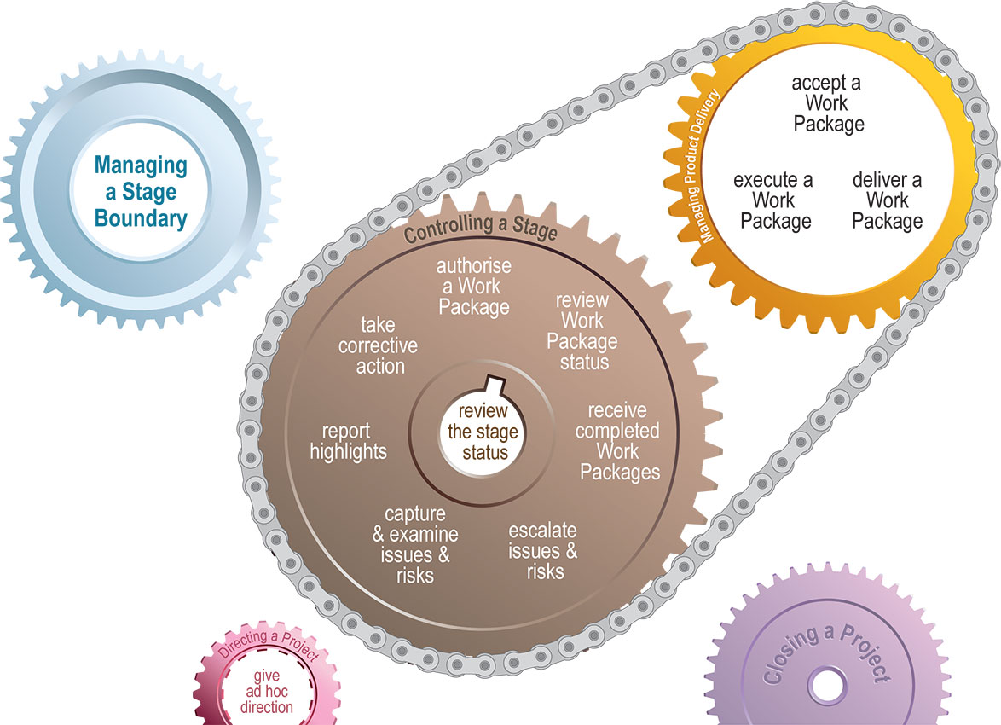
Controlling a Stage
Process

Slide 4
Controlling a Stage
Introduction
Stage status is constantly reviewed
Work Packages are authorised, reviewed and received once completed
Issues are captured, examined and dealt with
Reports are received from the Team Manager and sent to the Project Board.

Slide 5
Controlling a Stage
Objectives
Manage the Work Package
Manage issues & risks to ensure they are kept under control
Monitor and report to ensure the Business Case is kept under review & managed within tolerances.

Slide 6
Controlling a Stage
Activities
Authorise a Work Package
  Work commences and continues with Project Manager's consent
  Triggers include stage authorisation, exception plan, corrective action.
Review Work Package status
  Assess Team Manager time and effort
  Then update registers and stage plan with actuals-to-date.
Received completed Work Packages
  Confirm work has been completed and approved
  Check Quality Register and Configuration Item Records.

Slide 7
Controlling a Stage
Activities
Review stage status
  Maintain accurate picture of progress and status of resources
  Triggered by Project Board advice, forms the analysis of issues and risk or is performed regularly to produce the Highlight Report
Report highlights
  Progress monitoring tool for Project Board to manage by exception
  Source information from Checkpoint Reports, Registers, Lessons Log and Product Status Account.

Slide 8
Controlling a Stage
Activities
Capture and examine issues and risks
  Issues and risks are dealt with formally (through registers) or informally through the Daily Log.
  Undertake 'review stage status' prior to escalation or taking action
Escalate issues and risks
  If tolerances are threatened then the issue or risk needs to be escalated as an Exception Report to the Project Board.
Take corrective action
  Collect information, identify potential solutions, trigger implementation and update registers and records.
  New Work Packages can be issued to deal with the issue or risk.

Slide 9
Controlling a Stage
Principles
Continued business justification
Learn from experience
Defined roles and responsibilities
Manage by stages
Manage by exception
Focus on products
Tailor to suit project environment

